Slide 1

Google Data Analytics
Case Study
How Does a Bike-Share Navigate Speedy Success?
By: Meet Kotadiya
Date: 1st April 2023

Slide 2


Content:
Identify the business task
Data sources
Cleaning or manipulation of data
Analysis
Key finding
Applying the insights
References

Slide 3

Identify the Business Task
A bike-share program that features more than 5,824 bicycles like traditional bikes, reclining bikes, hand tricycles, and cargo bikes and 692 docking stations.
Cyclistic users are more likely to ride for leisure, but about 30% use them to commute to work each day.
Pricing plans: Single-ride passes, Full-day passes(referred to as Casual riders), and Annual memberships(referred to as Cyclistic members).
It’s being concluded that annual members are much more profitable than casual riders and there's very good chance to convert casual riders into members.
So, our business task is to do analysis of the provided data to answer the following question:
How do annual members and casual riders use Cyclistic bikes differently?

Slide 4

Data Sources
I use Cyclistic’s historical trip data of the previous 12 months to analyze and identify trends.
The data has been made available by Motivate International Inc. under this license.
The data is organized in a month-wise format.
The variables in the data are Ride ID, Type of Bike, Started at, Ended at, Start Station Name and ID and Location Coordinates, End Station Name and ID and Location Coordinates, Type of Membership.
We can say that our data is ROCCC(Reliable, Original, Compressive, Current, Cited).
Let’s start the process phase to know the credibility of the data.

Slide 5

Cleaning or Manipulation of Data
First of all with the help of Microsoft Excel, I made some new variables which can be very useful in our analysis like:
Ride Time – The difference of ended at and started at.
Day(of Week) – Applied a formula for finding the day of date in started at column.
Then imported the data into R Studio and started cleaning data by merging data of various months into one dataset and cleaned the missing value properly.
After that with the help of lubridate(library in R), separated the Date, Month, Year from the DateTime format.
Now the data is ready for the analysis….

Slide 6

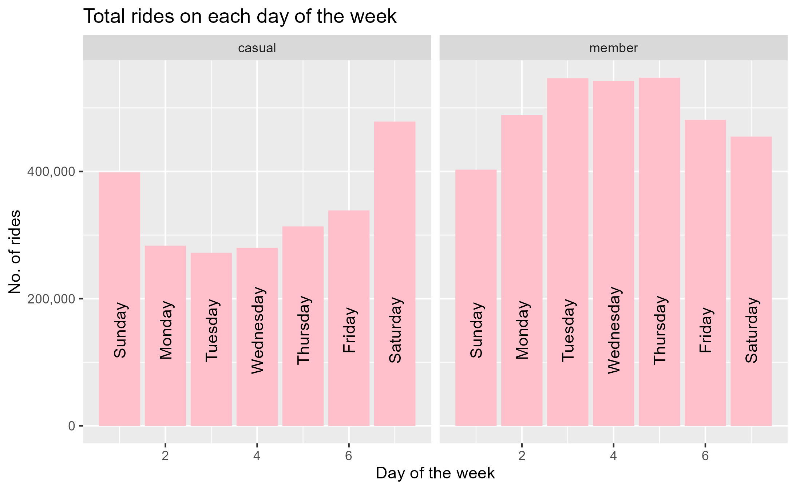
Analysis
Here in the case of Casual Riders, we can see that there is incline in number of rides on Sunday and Saturday.
While for the Member Riders, there is a decline in a number of rides on Sunday and Saturday.
Conclusion :-
Member Riders using the service are using it for the Occupational purposes and the Casual Riders using it for the Recreational purposes.

Slide 7
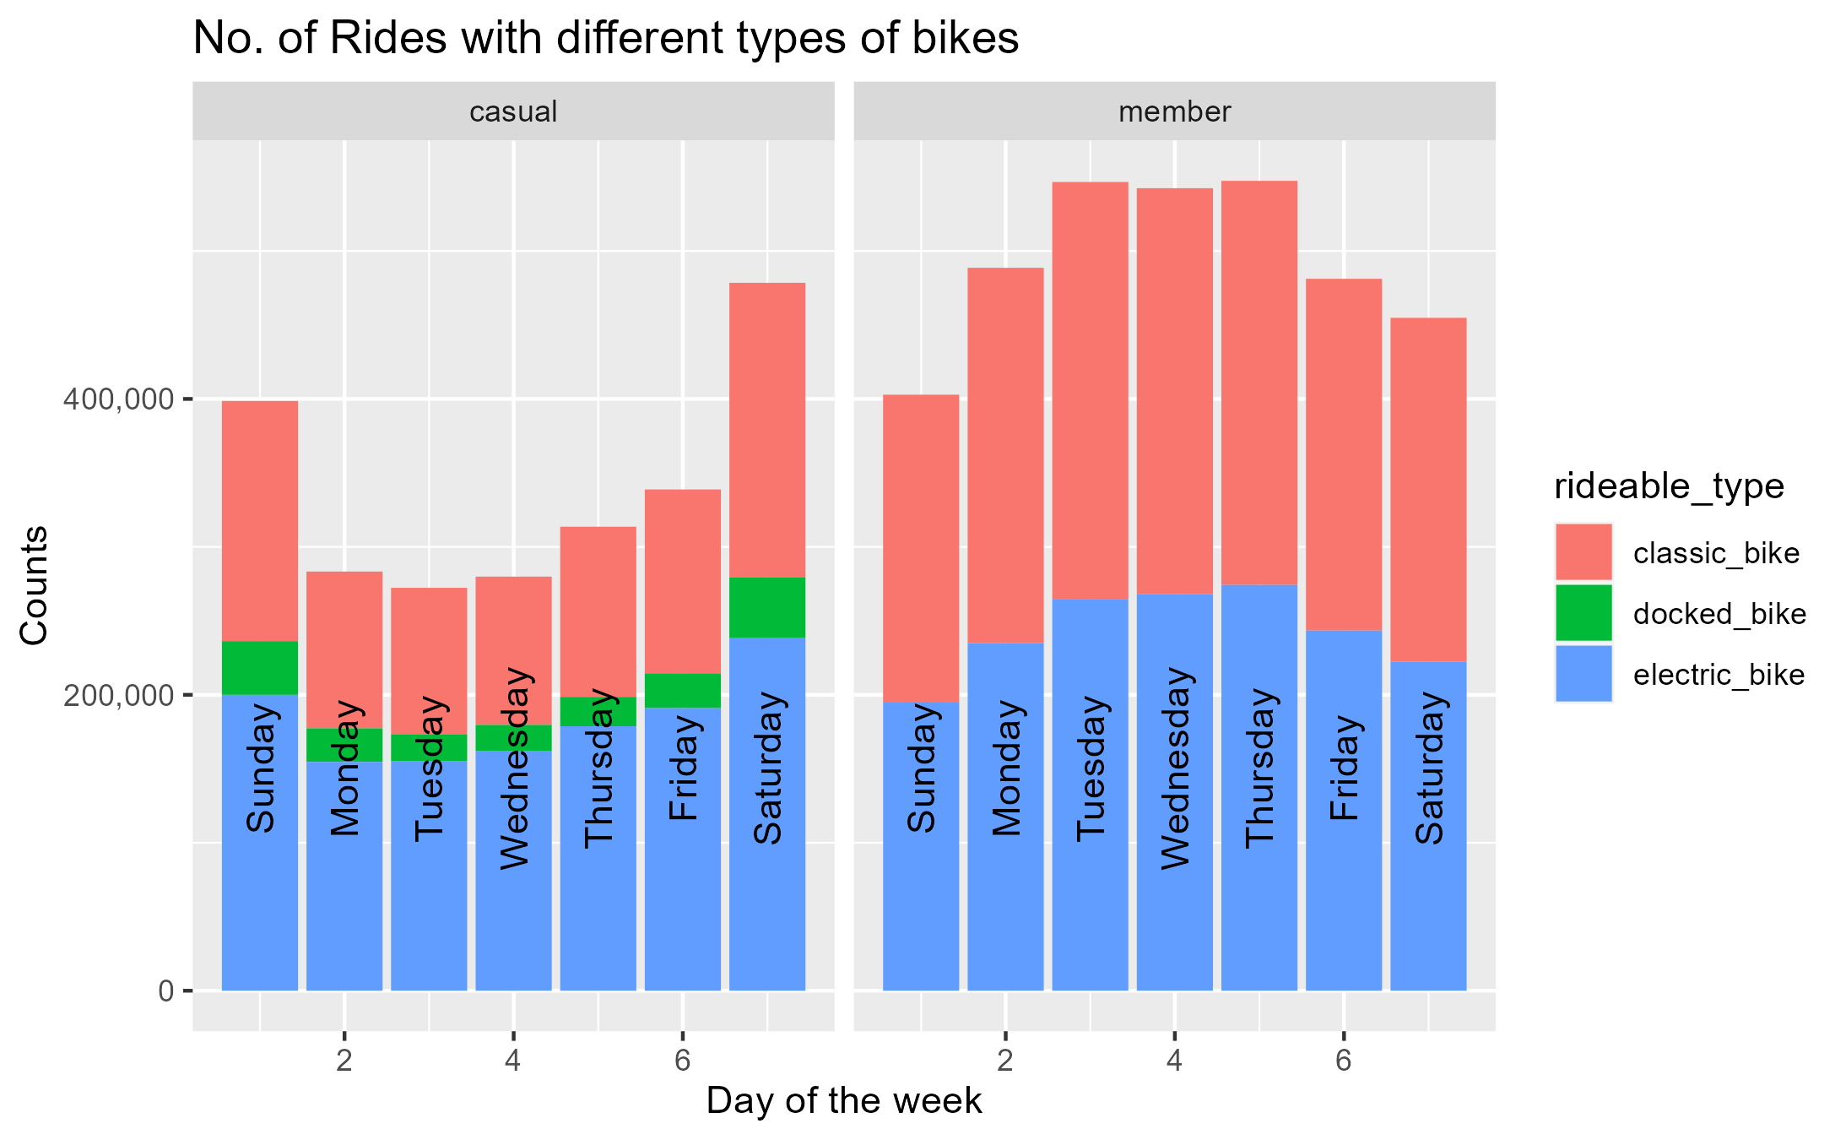
Analysis
In the case of Member Riders, Classic Bikes are used more than Electric Bikes.
But for the Casual Riders, the use of Electric Bikes are comparatively more than Classic Bikes.
Conclusion :-
Majority of the Annual Membership Riders uses it for the fitness purposes and majority of the Casual Riders uses it for travel and exploring purpose.

Slide 8
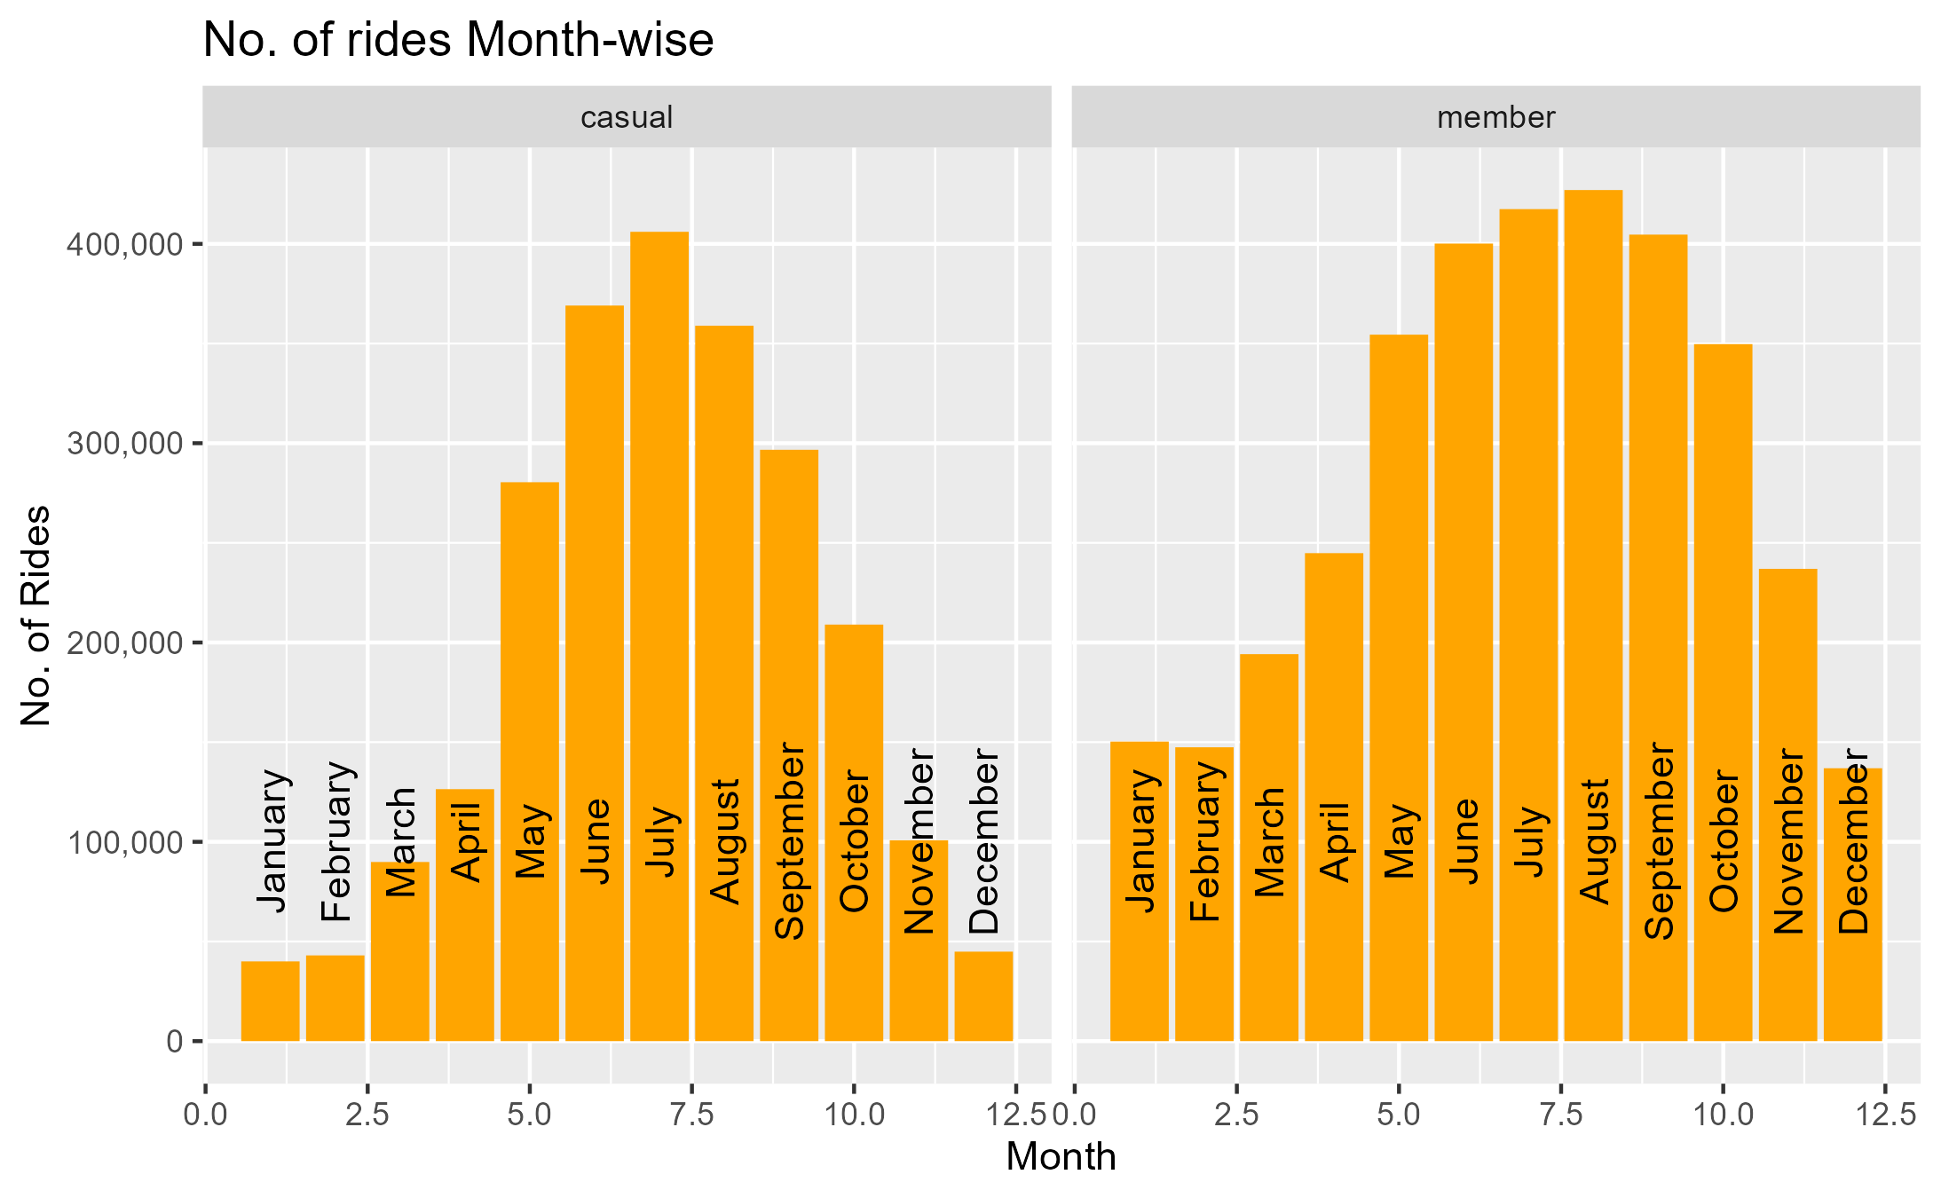
Analysis
In case of the Casual Riders, there is much decline in the number of rides for the month of November, December, January, February, March.
For Member Riders, there’s also a similar decline for the same months.
Conclusion :-
There is a great decline on the months from November to March as in Chicago, winters are going on.
Note :- No conclusion for this analysis as it’s not relevant to our business task but this finding can help in Marketing Strategies.

Slide 9
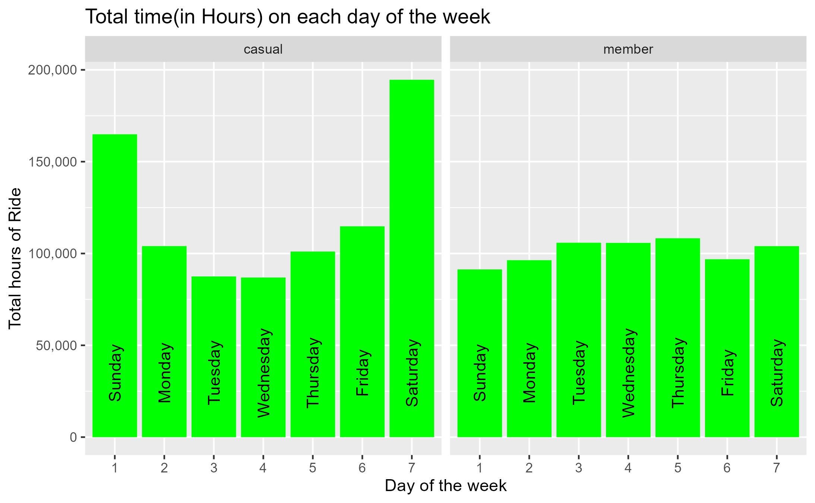
Analysis
Overall Casual Riders are using more hours of time to ride bicycle and on Saturday, Sunday it reaches to the peak.
For the Member Riders, there’s consistency in the hours of ride and small decline on the Sunday.
Conclusion :-
This again proves our previous conclusion that the Members uses the service for fitness and occupational purpose and Casual Riders uses it for travel on Weekdays and on Weekends for recreation.

Slide 10



Key Findings
Casual Riders | Member Riders
Recreational purposes – Increased number of rides on the Weekends | Occupational purposes – Comparatively more rides on Weekdays
Travel/Exploring purposes – Use of Electric bikes more than Classic bikes | Fitness purposes – Use of Classic bikes more than Electric bikes
As we now have some of the insights about the behaviors of our different types of the customer, we can apply those insights to make the best marketing strategies…

Slide 11

Applying the Insights
To convert the Casual Riders into Annual Membership Riders, some of the best actions will be the following :-
Since majority of the customer having membership are some fitness and health conscious so we can plan to increase the marketing in the various fitness centers.
Other group of people having membership are the regular workers and environmentalists, and to target that group of people we can tie up with some institutes and NGOs.
There is a big incline in the casual riders on the weekends so either we can launch a different kind of the membership for weekends only or we can advertise on the recreational centers like Malls and Tourist places.

Slide 12

References
For more Information:
Contact No. : 8780754314
Email : kotadiyameet173@gmail.com
LinkedIn : My Profile
To get complete process of the analysis step by step on R Markdown, click the following links :
HTML Format (Download and open with your browser)
Pdf Format
Word Format
Here are some of the Datasets that are made during the analysis process:
Weekly Analysis
Monthly Analysis
Average Time Analysis
And finally plots :
First
Second
Third
Fourth

